Slide 1
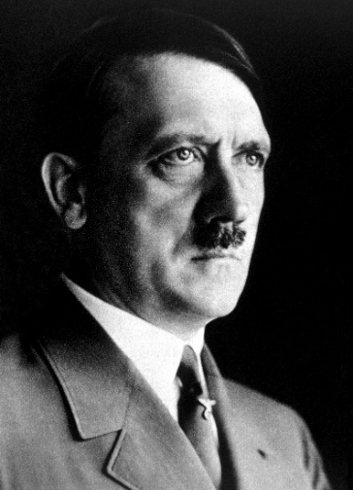
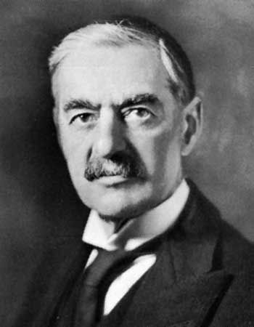
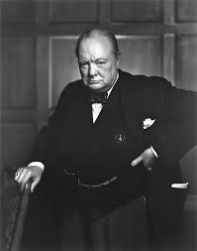
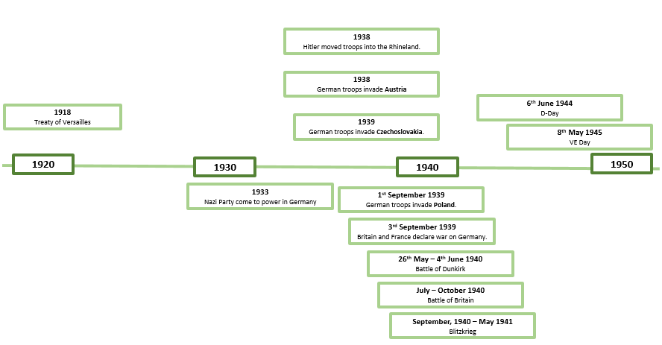
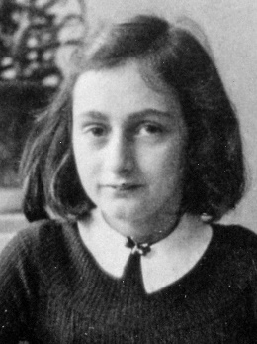
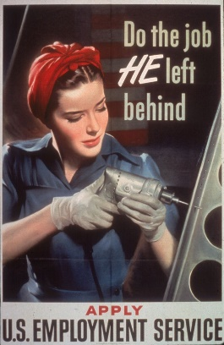
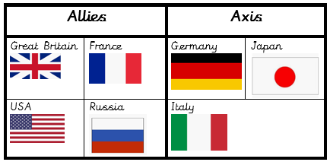
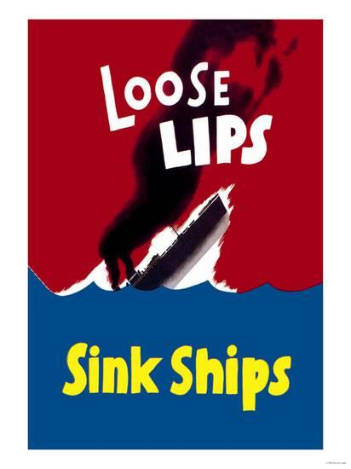
Vocabulary
Treaty | written agreement between countries to do a particular thing or help each other
Tyrant | someone who treats the people they have authority over in a cruel and unfair way
seize | taking control of a place quickly and suddenly, using force
Propaganda | information of a biased or misleading nature, to promote a political cause or point of view
morale | confidence, enthusiasm and discipline of a person / group at a particular time
Nazi | a member of the National Socialist German Workers’ Party
fatality | a death caused by an accident or by violence
Holocaust | the killing of millions of Jews by the Nazis
rationing | a system to limit the amount of food you were allowed to buy
Blitz | attacked by bombs dropped by enemy aircraft
evacuate | to send someone to a place of safety, away from a dangerous building or area
interpretation | explaining the meaning of something
History – Year 6
Autumn
What should I already know?
Know and sequence key events of time studied and compare to previous learning (e.g. knowing where events are in relation to each other).
Adolf Hitler
German leader of the Nazis during World War II. responsible for the Holocaust as well as starting World War II by invading Poland in 1939. born in Austria, Hitler served in the German army during World War I.
Significant People
Neville Chamberlain | Prime Minister of Britain during the outbreak of WW2.
Winston Churchill | Prime Minister of Britain during the majority of WW2.
Anne Frank | a victim of the Holocaust who kept a diary of her time in hiding
George Holland | local war hero
Historical Themes
Conflict | Social Justice
Operation Pied Piper
Historical Skills
Historians give reasons why there may be different accounts of history. Historians choose reliable sources of evidence to answer questions and compare. Historians can explain why changes may have occurred but recognise that some evidence from the past is propaganda, opinion or misinformation, and that this affects interpretations of history.

