Slide 1
School Readiness

Slide 2
What is school readiness?
Notes:
There is no official definition of school readiness.
Amanda Spielman Her Majesty’s chief inspector of Education has given a reasonably rounded view of school readiness.
This encompasses
language skills,
basic hygiene
physical development.

Slide 3
Areas of development
Notes:
These are the 17 areas of learning that we assess against in the Early Years.
The prime areas are important because they lay the foundations for children's success in all other areas of learning and of life . If the children are confident in the prime areas the academic side of things should naturally follow.

Slide 4
Why is school readiness so important?
https://www.youtube.com/watch?v=cr_dCuVpK4s

Slide 5
Parents’ perceptions of what their child should be able to do at the age of school entry are frequently oriented towards academic accomplishments such as counting and knowing the letters of the alphabet. (Unicef)
Notes:
These are the areas that we work on as a school. Don’t get too hung up on these areas. Often parents can become consumed with academic accomplishments rather than ensuring that their child is independent.
So what are we expecting your child to be able to do when they start in September? Ofsted suggest that…

Slide 6
Ofsted 2014
By four we would expect children to be separated from their parent/ carer.
To be able to demonstrate listening skills.
Pay attention to a subject or stimulus.
To have enough language to be able to express themselves if they need something and also be able to share information about themselves.
To be able to interact with an adult and peer – take turns.
Show interest in their work and the world around them.
Notes:
Ofsted suggest that …

Slide 7
Amanda Spielman
Most children should be able to sit still and listen for the duration of a good story and understand the words ‘no’ and ‘stop’. It’s desirable for them to put on their own shoes and take off their coat.
On top of that, they need solid foundations for physical health. They need to eat healthily, sleep at appropriate times and get regular exercise.
One important basic skill for 4-year-olds is being able to use a toilet. This is a simple, but necessary, expectation.
Notes:
Amanda Spielman Her Majestys Chief inspector says…
More and more schools report children turning up on their first day of Reception unable to do this. There have been recent news stories about children being sent to school in nappies! A recent ATL survey found that some 70% of schools were finding more children were starting school without being toilet trained, compared with 5 years ago.
This has a detrimental impact in the classroom because of the amount of time teachers are spending cleaning up after children having accidents.

Slide 8
What does your child need to be able to do?
Tell you when they need to use the toilet
Ensure that most of the time they remember to go to the toilet in time.
Wash and dry their hands by themselves
Put their arms in their coat when it is held open for them and do the zip up once it has been started.
Hold a knife and fork and feed themselves
Notes:
These are things that you can practise with your child at home.
Once you have bought your child’s PE kit let them practise getting dressed and undressed.
Model washing and drying your hands.
Eat dinner without any distractions to enable your child to concentrate on using their knife and fork correctly.

Slide 9
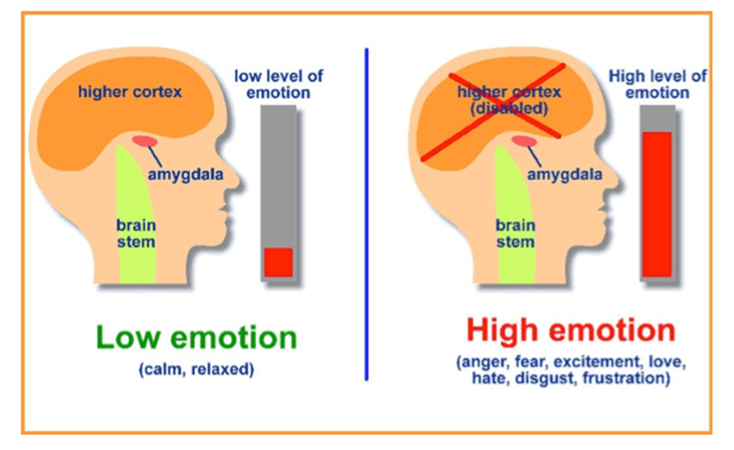
How does school readiness relate to a child’s happiness?
Notes:
If children are unsure/ unable to be independent then this in turn can mean that they develop higher levels of stress through feelings of embarrassment and frustration.
We should take time to consider the impact that stress exerts on a child’s developing brain. When emotions hijack the brain, it means that the ‘thinking’ parts of the brain instantly become compromised and therefore unable to execute their functions, as there is no time for rational thought.
This means that the child may become angry, upset, despondent which then has a detrimental impact on the level of learning taking place.

Slide 10
The three dimensions of school readiness are:
(1) Ready children, focusing on children’s learning and development.
(2) Ready schools, focusing on the school environment along with practices that foster and support a smooth transition for children into primary school and advance and promote the learning of all children.
(3) Ready families, focusing on parental and caregiver attitudes and involvement in their
children’s early learning and development and transition to school.
All three dimensions are important and must work in tandem.
Notes:
We are a partnership and must work together to ensure the best outcome for your child.

Slide 11
What can you do to prepare your child for school?
Give them the experience of going to new
places, be able to play with new things and
people, knowing you are close by.
Give them the time to do things on their own.
Give them the opportunity to play with new
objects and tools to find out how they work
and be allowed to choose things for themselves for example when making a picture.
Share books, sing nursery rhymes and songs.
Notes:
2. Time is crucial – children need to be allowed to do things for themselves without the worry of time constraints . They may be slow to start but the more often they do something the quicker and more confident they will become. I know it is easy to jump in and do things for your child because we are constantly busy but it is important to make the time to allow them to do it. Give them lots of praise for being willing to give things a try without your help.
3. By giving your child time to experiment with new things this will develop their curiosity and enquiry skills
4. A child uses language from books that have been read to them as part of their everyday speech and in turn we can’t expect a child to write something they haven’t heard.

Slide 12
A child’s first teacher is their parents.
You are the greatest teacher and role model.
Remember: Allow your child time to develop their independency skills.

Slide 13
Thank you!

