Slide 1
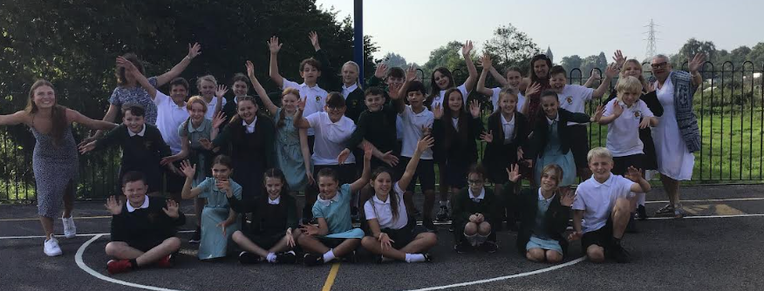
Year 6 – Chestnut
‘Our Wonderful World’
Curiosity
Broadmindedness
Creativity
Responsibility
Enjoying Life
Sense of Belonging
Miss Evans
Hopefully I will have given all of the information but I will answer any questions at the end if not!

Slide 2
Key dates
Autumn | Spring | Summer
School trip to Stockport Air Raid Shelters – 13th October Parents’ Evening 1st and 2nd November Crucial Crew – 21st November | SATs Meeting - Feb Spring Break – SATS Revision Packs will go out | SATs Week 13th May –16th May 2024 Residential 19th June – 21st June

Slide 3
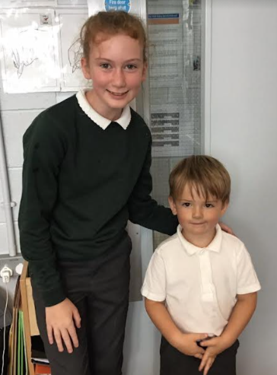
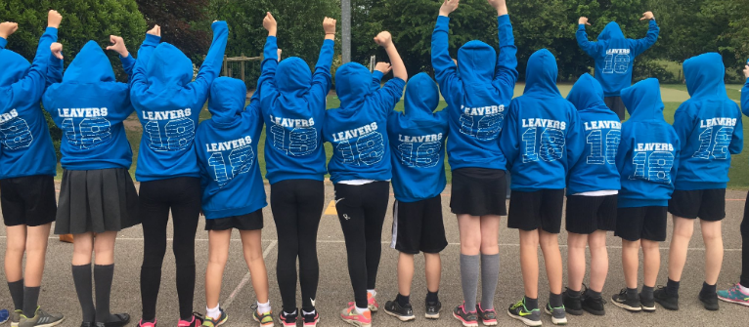
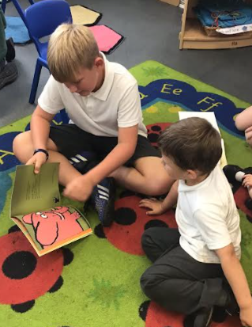
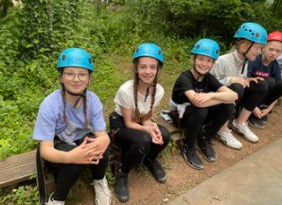
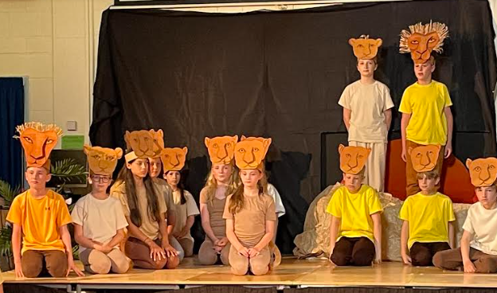
Highlights of Year 6

Slide 4
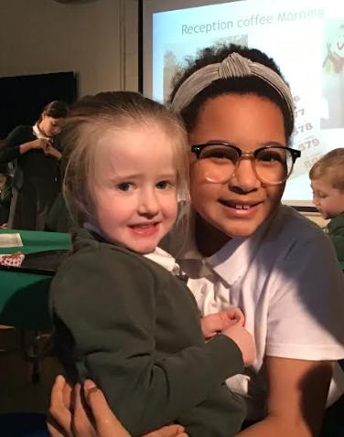
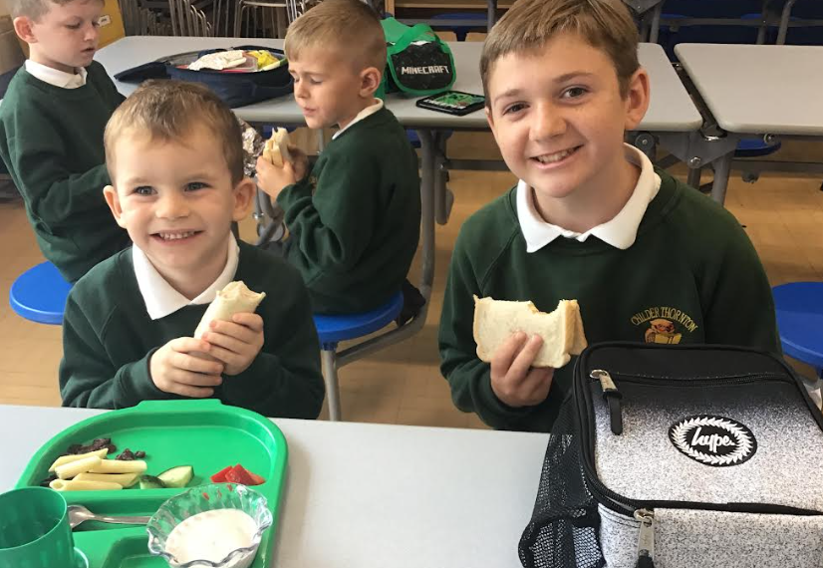
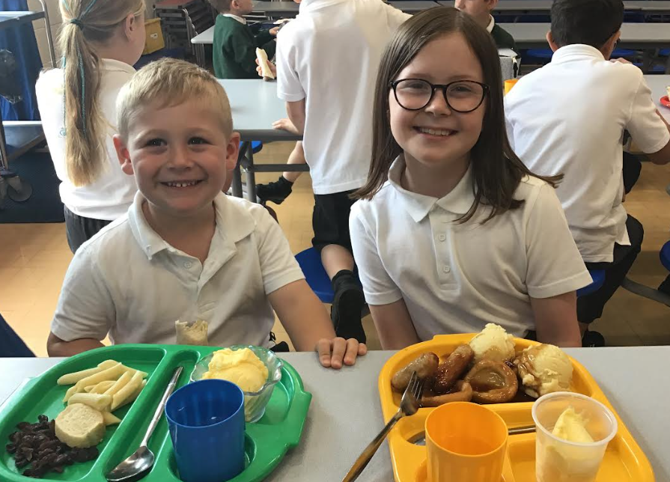
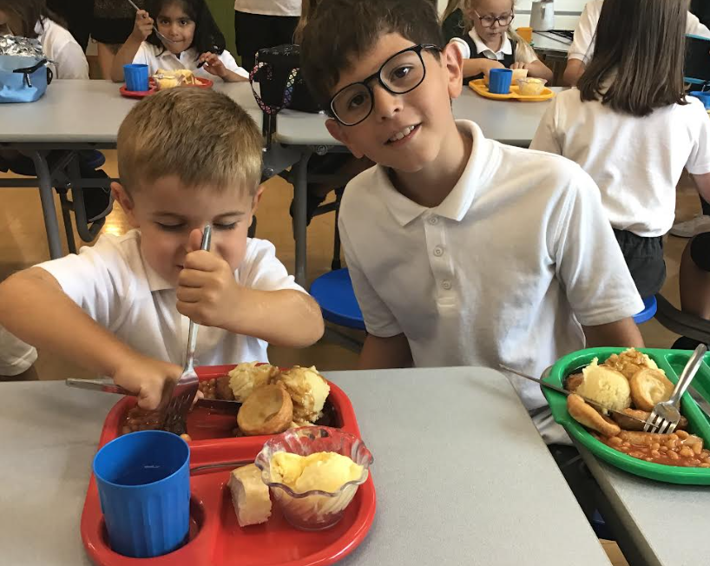
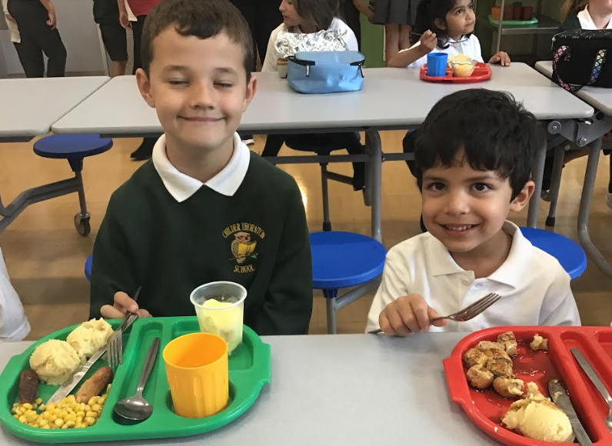
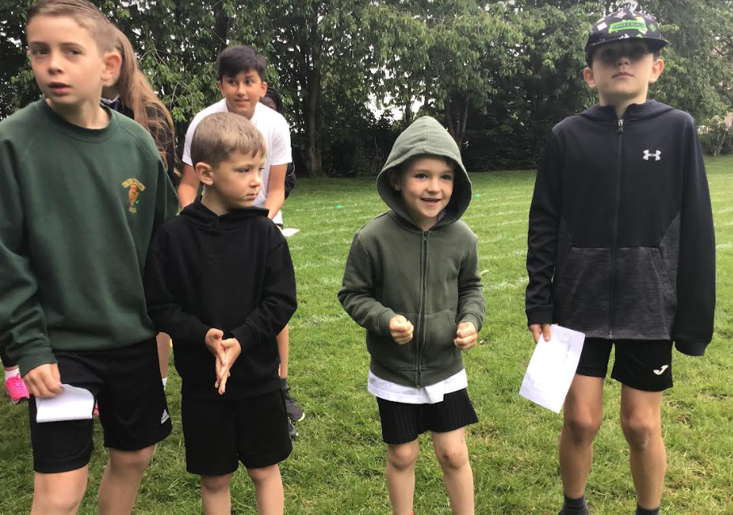
Buddies

Slide 5
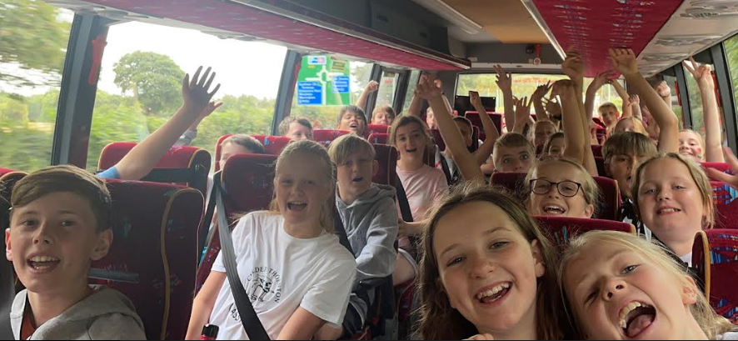
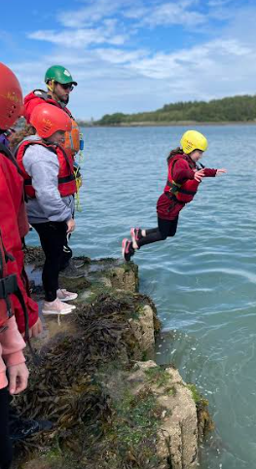
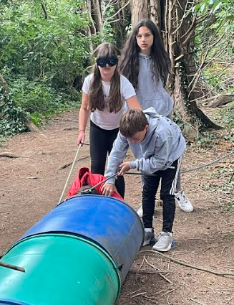
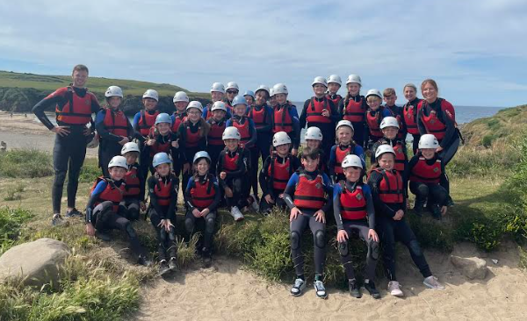
Conway

Slide 6
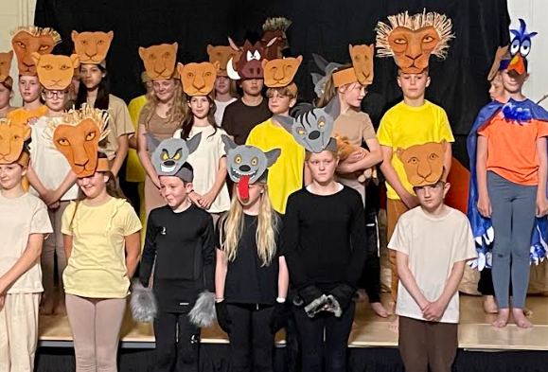
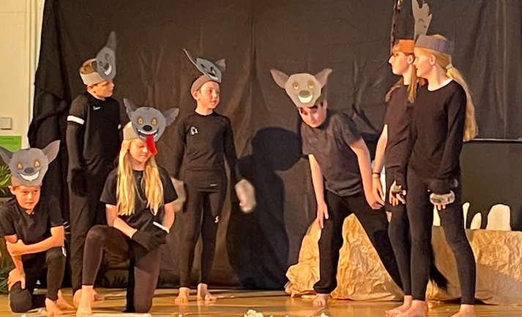
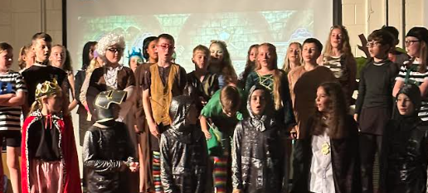
End of Year Production

Slide 7
SATS – only a fraction of Y6!
Maths
Arithmetic Paper – 30 minutes
2x Reasoning Paper – 40 minutes
Reading
Reading Paper - 1 hour
SPAG
Spelling Paper
Grammar Paper – 45 minutes
More information at the SATs meeting – February.
Relaxed
Prepared
Ready!

Slide 8
Timetable
 | Monday | Tuesday | Wednesday | Thursday | Friday
AM |  |  |  |  | Reading diaries
PM |  | PE | New spellings – every week. Practise the words little and often!
 | SPAG.com - HW | Music | Spanish – every other week
PE - kits to be brought in at the beginning of the week and taken home at the end.
Forest Schools – old clothes and spare change as we approach the winter months.
Music – brought to and from school on a Tuesday

Slide 9
Curriculum

Slide 10
History and Geography
Autumn | Spring | Summer
World at War WW2 Why it started Significant events and people Propaganda | Time for change? Climate change project linked to protecting our planet – the world the children will be living in. More information – beginning of Spring Term | INVADERS Anglo-Saxons and Vikings Who were they? Impacts on the way we live today. More information – beginning of Summer Term
Knowledge Organisers
Using the vocabulary confidently
Recognising key dates and plotting on a timeline
Recalling facts on important historical moments

Slide 11
Maths
Autumn | Spring | Summer
Place Value Four Operations Fractions Geometry – Position and Direction | Decimals Percentages Algebra Imperial and Metric Measures Perimeter, Area and Volume Ratio and Proportion | Shape Problem Solving Statistics SATs

Slide 12
English - writing
Autumn | Spring | Summer
History / Geography unit: World at War Second World War Aut 1 Star of Fear Star of Hope Aut 2 The Day the War came | History / Geography unit: Time for change? Climate Change Sp 1 Plastic Planet Sp 2 Kong | History / Geography unit: INVADERS Anglo-Saxons and Vikings Sum 1 Jeremy Button Sum 2 Sky Chasers

Slide 13
English - reading
Class page – website
It is important that your child is reading frequently to support their writing – building vocabulary, recognising spelling patterns.
Reading regularly will improve their reading speed – supporting them when it comes to the reading paper.
T will check recorded in their reading records – by an adult or child.

Slide 14
English - reading
Reading with your child and questions you might want to ask.
Retrieval – literally pulling it from the text
Who went to fetch the eggs from the shop?
Why did Tom move his tractor?
Prediction
What may happen next?
Who is going to do something?
Inference – inferring something using evidence in the text to prove this
Point evidence, point evidence
What impression did you get of Billy? (Point and why)
Why might Bob think Bill is …..?
Compare
Summarise

Slide 15
English - SPAG
Spellings:
New sp in log books every Wednesday.
New class set has been ordered!!
Spag.com:
Monday (logins in the back of their diary)
Follow up from the sessions in school on particular spelling rules.

Slide 16
Science
Autumn | Spring | Summer
Light Electricity | Living things and their habitats Animals including Humans | Evolution SRE – you will receive info before this unit.

Slide 17
Homework
Reading – ‘strive for 5’
TTRS
10 minutes on Garage (personal to the child)
5 minutes on Studio
Spellings – Wednesday
SPAG.com – Monday
Occasionally, the children may be given SATs follow up work or corrections to do at home.
Independent – it is their responsibility to complete this otherwise they will have to catch up during break times.
Thanks so much in advance for your support!!

Slide 18
Information
Website – Chestnut class page
Twitter
Letters / emails / text

Slide 19
Thank you in advance for your support!
We are really looking forward to working with your children this year! If you have any questions, please don’t hesitate to ask!

